Slide 1



ClassTrack
Mobile Attendance Monitoring System

Slide 2

Introduction
Traditional attendance systems are manual, error-prone, and inefficient.
Issues include proxy attendance, time consumption, and lack of transparency.
ClassTrack is developed to address these issues using modern mobile technology.

Slide 3
Objectives
• Automate attendance recording using QR code scanning.
• Provide real-time access to attendance records for students.
• Equip instructors with tools to manage and review attendance.
• Enable administrators to generate institutional reports.
• Ensure data security and access control.

Slide 4
Scope and Limitations
Scope:
• Supports Students, Instructors, and Administrators.
• Available on Android using React Native.
• Uses MongoDB for real-time data storage.
Limitations:
• Requires internet connectivity.
• No GPS-based location validation in current version.

Slide 5
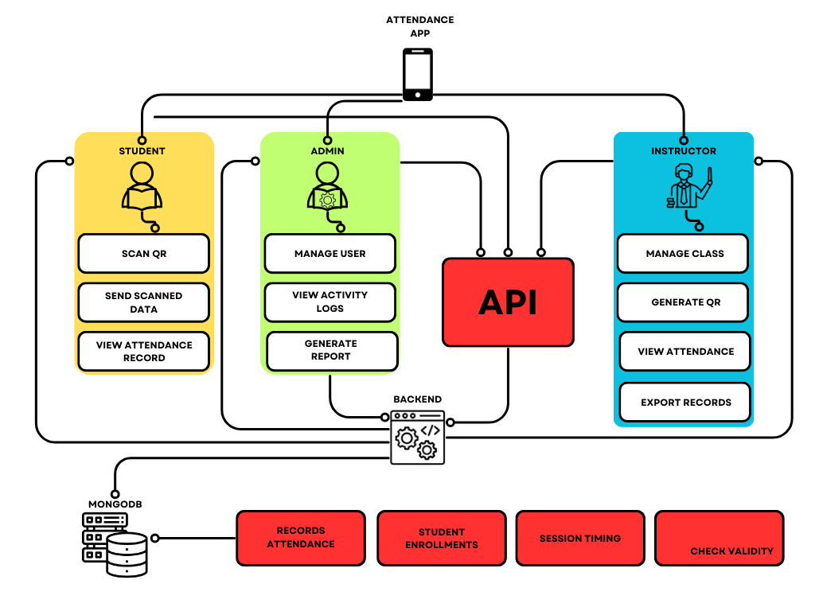
System Architecture

Slide 6
System Architecture
• Mobile App (React Native) – Frontend for users.
• API – Communication bridge to backend.
• Backend – Logic for validation and processing.
• MongoDB – Stores attendance, session, and user data.
• Role-Based Access Control ensures secure user operations.

Slide 7
System Features
• QR code generation and scanning for attendance.
• Role-based dashboards for each user type.
• Time-stamped logging of attendance entries.
• Report generation and data export options.
• Secure authentication and encrypted data storage.

Slide 8
Your name or organization
Thank you!

